Slide 1
Mars Rover - Team 09
Website:
Client:
Advisor:
sdmay19-09.sd.ece.iastate.edu
Joseph Zambreno
Craig Rupp
Mitchell Freshour:
Douglas Kihlken:
Calvin McBride:
Sam Westerlund:
Hardware Developer
Hardware Developer
Software/Hardware Developer
Software Developer
Notes:
http://seniord.ece.iastate.edu/resources/491_Final_Presentation.pdf - Guidelines

Slide 2
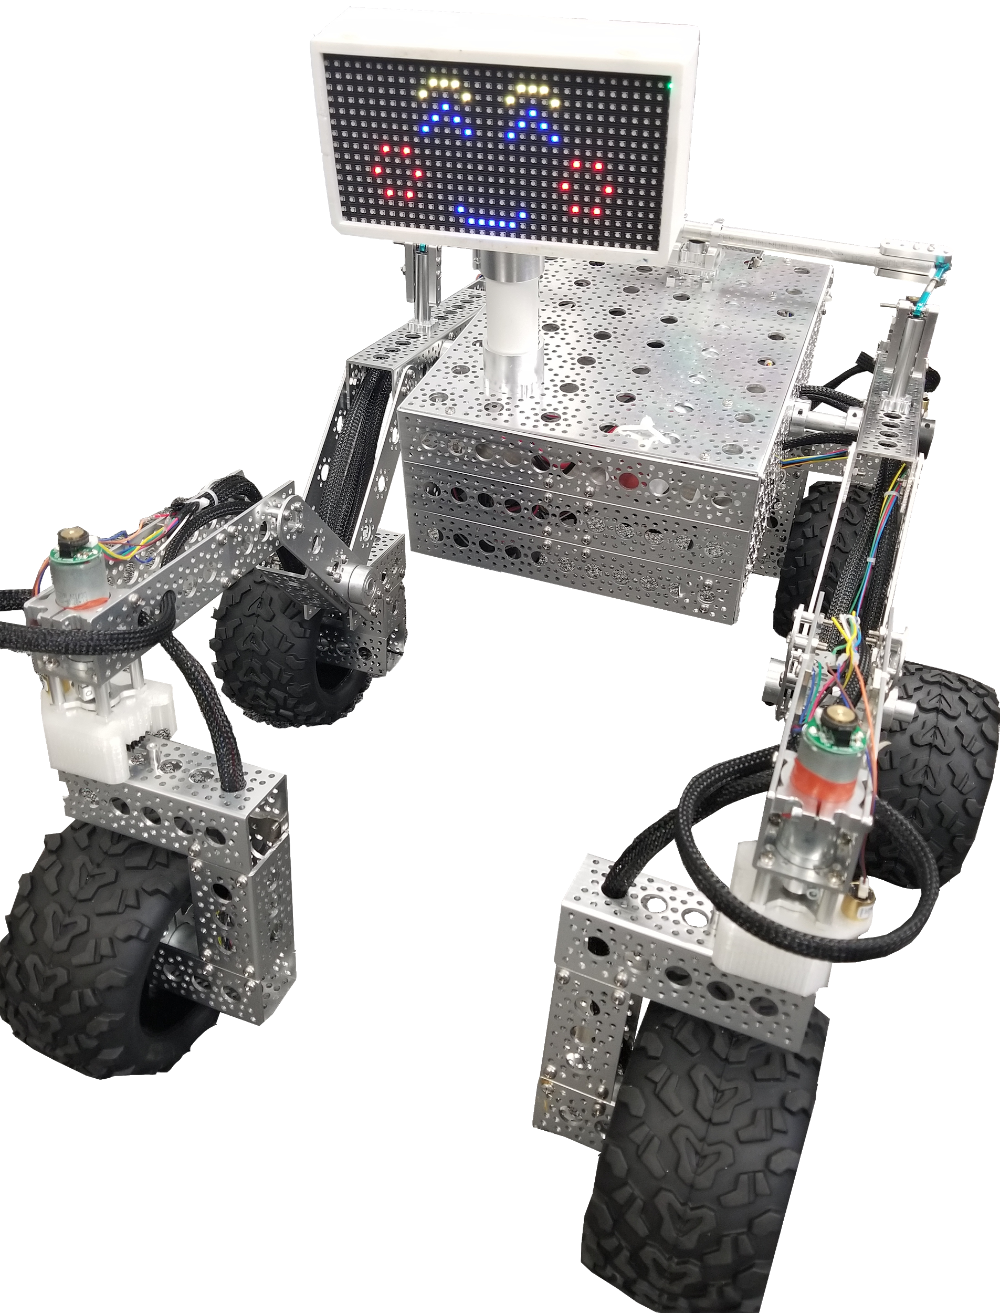
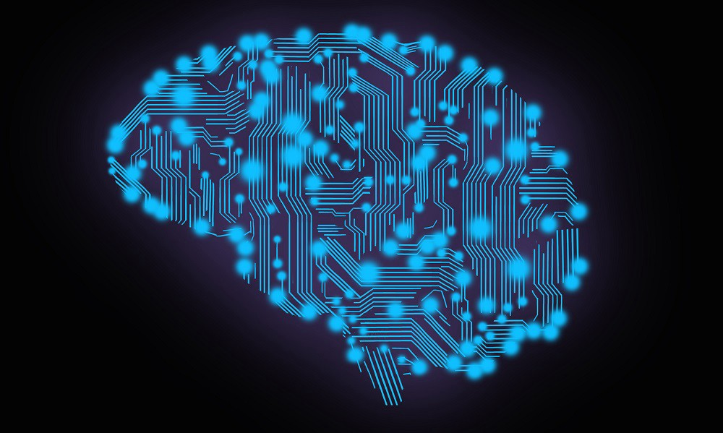
Problem Statement
Problem: Iowa State University’s ECpE department needs a show piece to capture the attention of and engage potential students and visitors at Iowa State University.
Solution: Construct a well-documented and extensible miniature Mars rover that can either be remote-controlled or navigate itself using machine-learning and computer-vision.

Slide 3
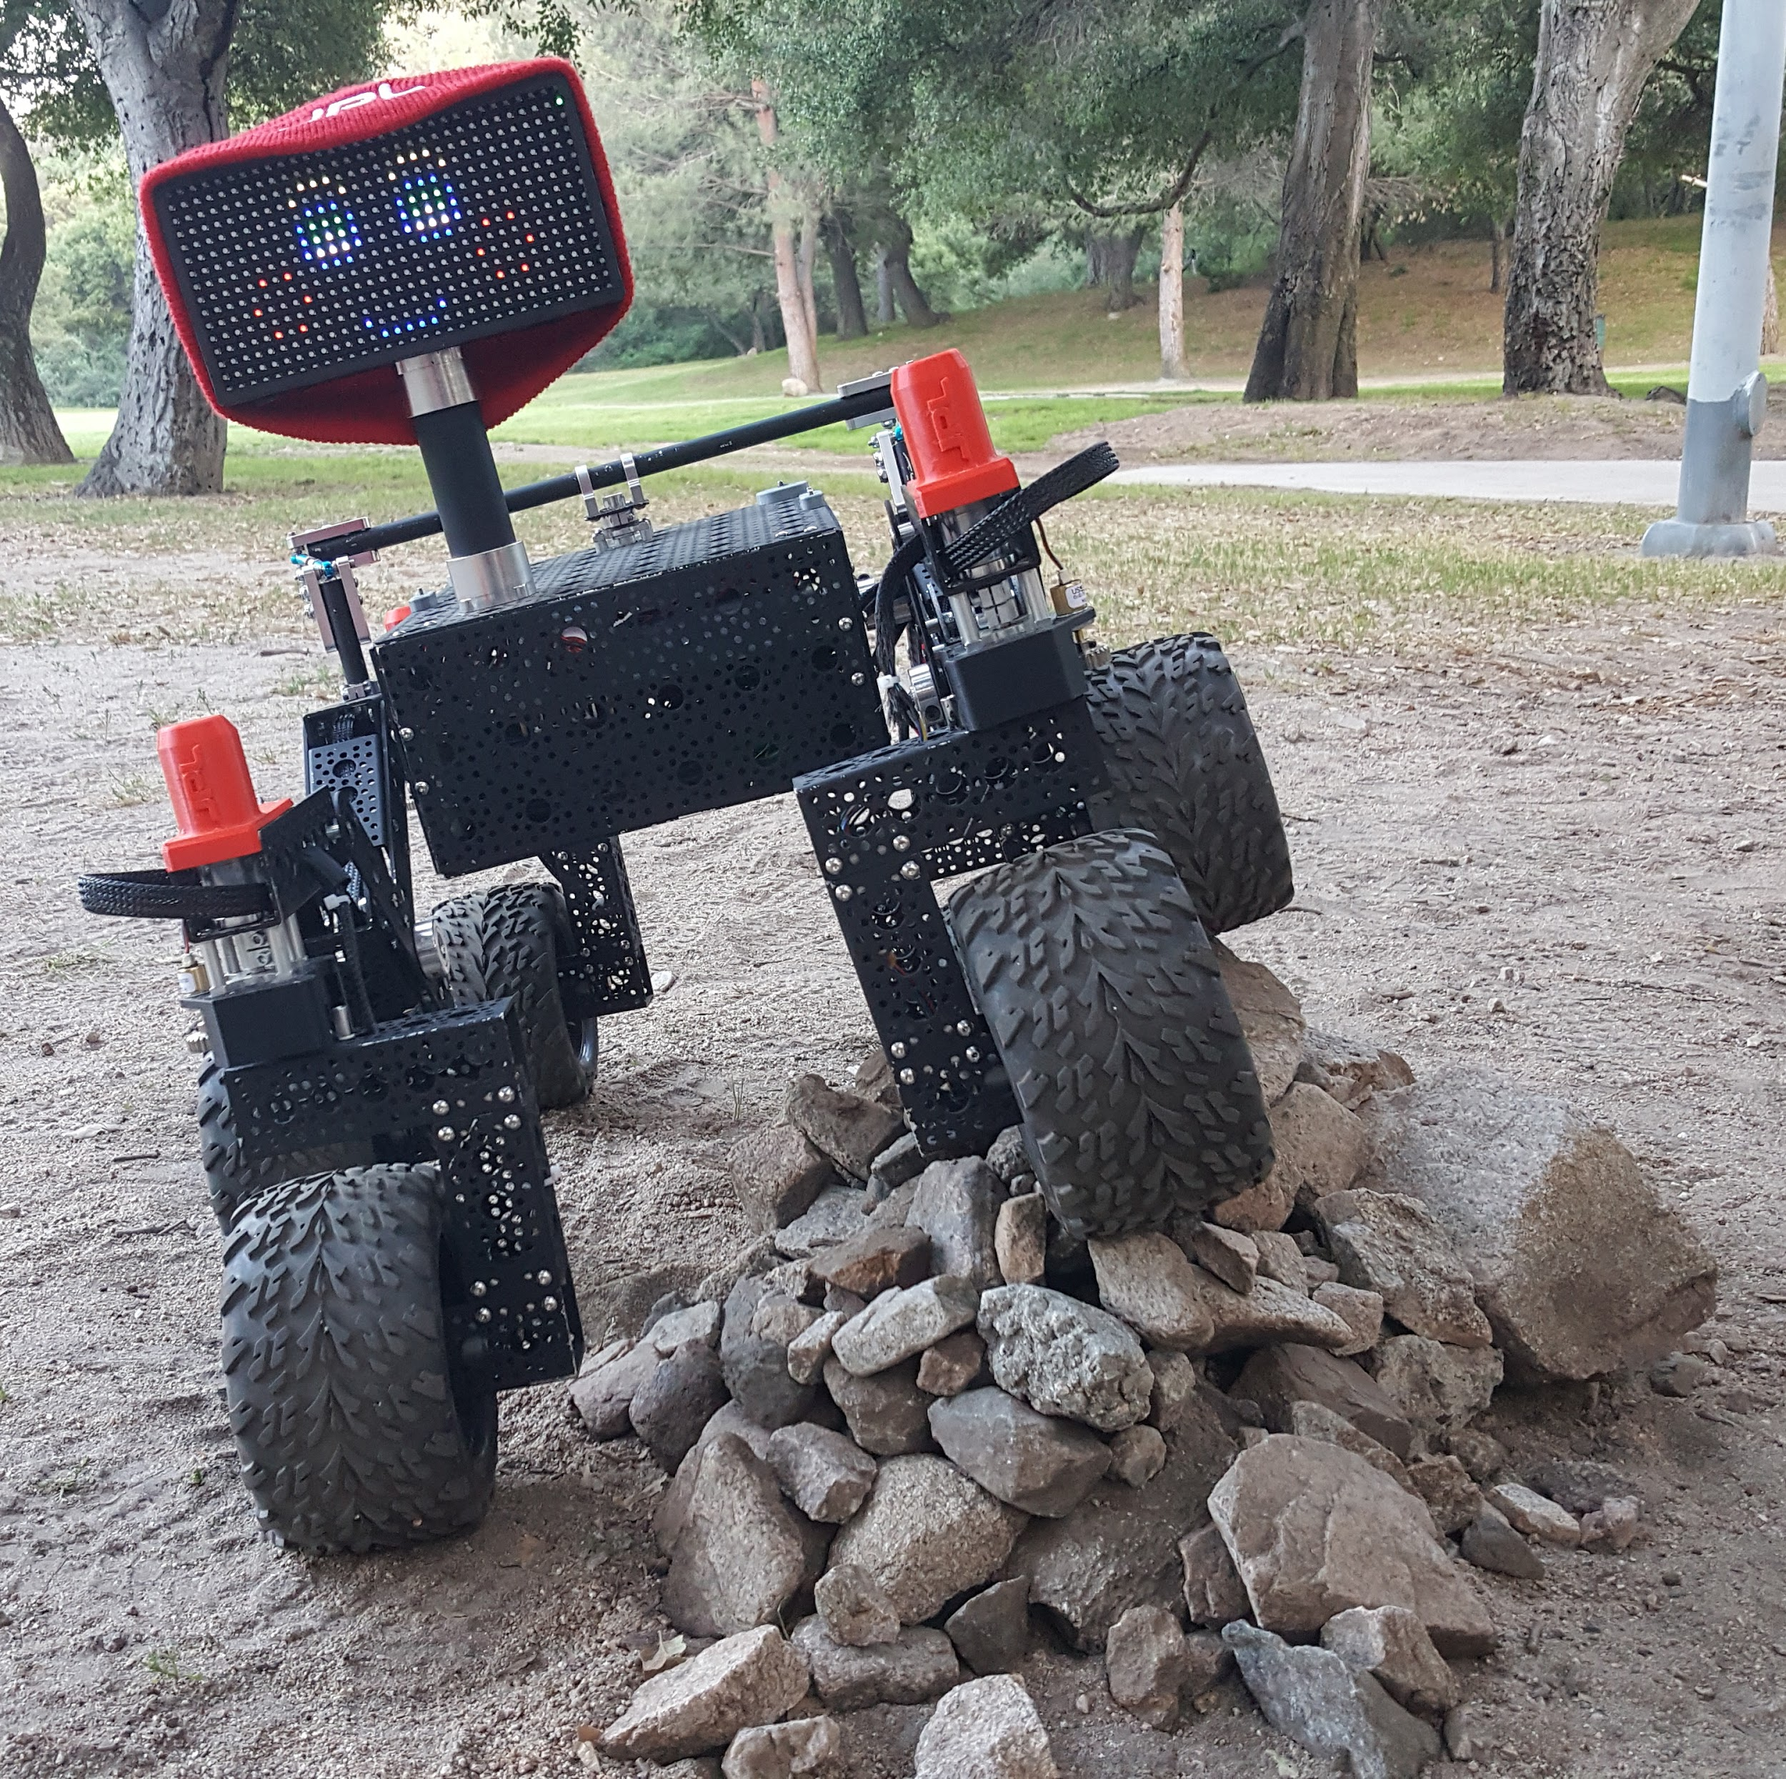
Project Design
Key Features
Autonomous Navigation
Computer Vision
Easy to start, stop, and manage
Easy to extend/add to for future teams
Components
JPL Open-Source Rover software (github.com/nasa-jpl/open-source-rover)
Camera and LIDAR sensor
LCD screen for display
Notes:
Object detection and avoidance
To aid in detection, avoidance and gives paths to possible expansion. Example object recognition
Again, keeping end users in mind, faculty, professors
Extendability key to use in possible future senior design projects
nasa JPL open source

Slide 4
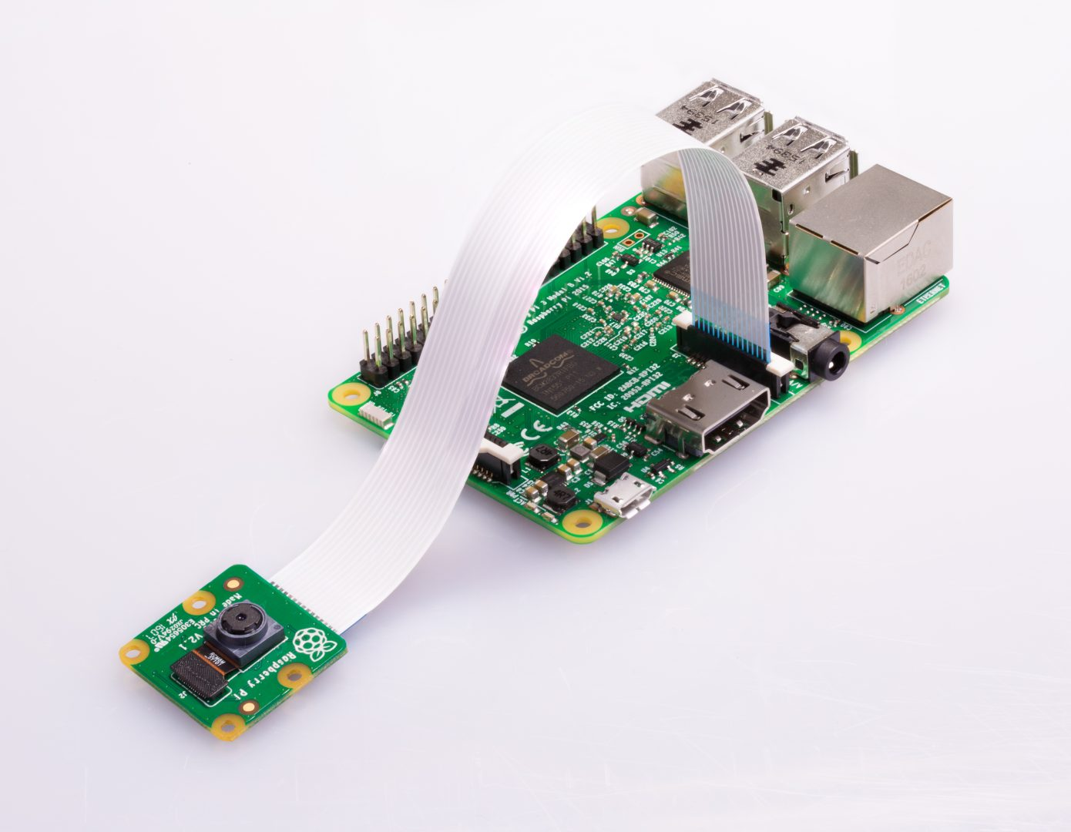
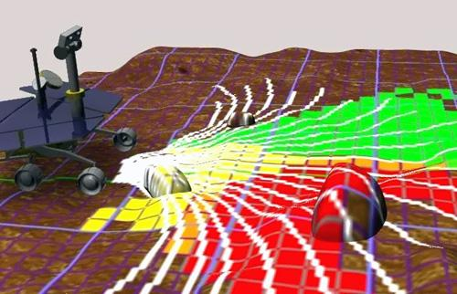
Functional Requirements
• Raspberry Pi should be able to take input from a controller, read and process hardware data, and stream camera visuals to user. • Working camera for computer-vision to self-navigate. • Algorithms to detect common indoor objects and people, as well as navigation algorithms to move around such items. • Working sensors (such as LIDAR, Sonar, Infrared, Camera) to “see”.

Slide 5
Non-functional Requirements
• Battery life must have a minimum of 2 hours. • Rover should take no more than 1 second to respond to manual user input. • Rover should take an average of 5 seconds to scan, process, and create a plan for navigating its environment, with a worst-case time of 10 seconds. • Remote-control signals should reach several meters, ideally throughout most of the a given building.

Slide 6
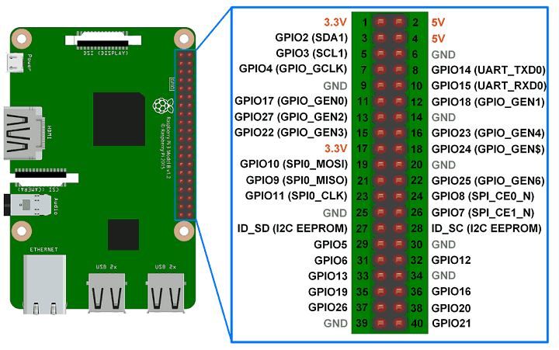
Technical/Other Constraints/Considerations
• The JPL Open-Source Rover base-build has a battery-life of approximately 4 hours, without additional modifications. • The rover uses a Raspberry Pi 3, which has a limited number of GPIO pins that are necessary for extending further hardware add-ons. • The project has a budget of $2,500. • The JPL Open-Source Rover documentation estimates a minimum of 200 man-hours by experienced teams to build the base rover.

Slide 7
Market Survey
Project customer is ECpE department
Audience will be prospective students to Iowa State University
Not going to be marketed as a product for sale

Slide 8
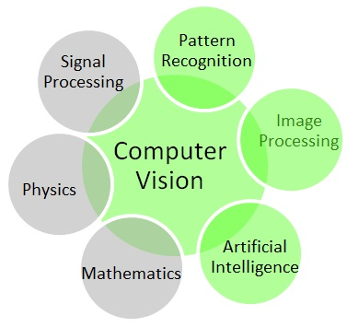
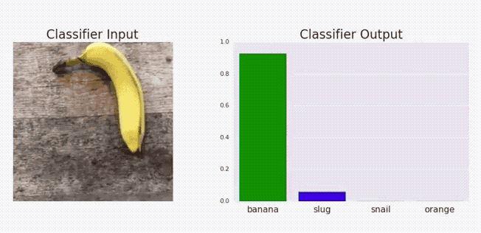
Potential Risks & Mitigation
• Many electrical boards are not vacuum-sealed, making them susceptible to bad weather and water. • Computer-vision is a relatively young field in computer science, making it a somewhat difficult task to implement for our junior team. • Computer-vision and machine-learning is a relatively high cost in terms of processing power, making the rover’s 3-4-hour battery life even shorter.

Slide 9
Resource/Cost Estimate
The project has a budget of $2,500.
JPL Open-source Rover documentation estimates just under $2,500 cost for rover build, as well as approximately 200 man-hours to construct.
Raspberry Pi camera ($24.90), Intel Movidius Compute Stick ($79.00) and LIDAR ($99.00) are additional costs on top of the JPL component list.
Likeliness of going over-budget was brought to client’s attention. Client felt it was acceptable.

Slide 10
Project Milestones & Schedule
Ordering and grouping of parts into individual components
September 2018
Completion of software prototype including Lidar mapping, and video processing to web interface
December 2018
Completion and testing of electrical components
December 2018
Machining and fabrication of parts
January 2019
Mechanical and electrical assembly of the rover
March 2019
Rover operational and improvements implemented
April 2019

Slide 11
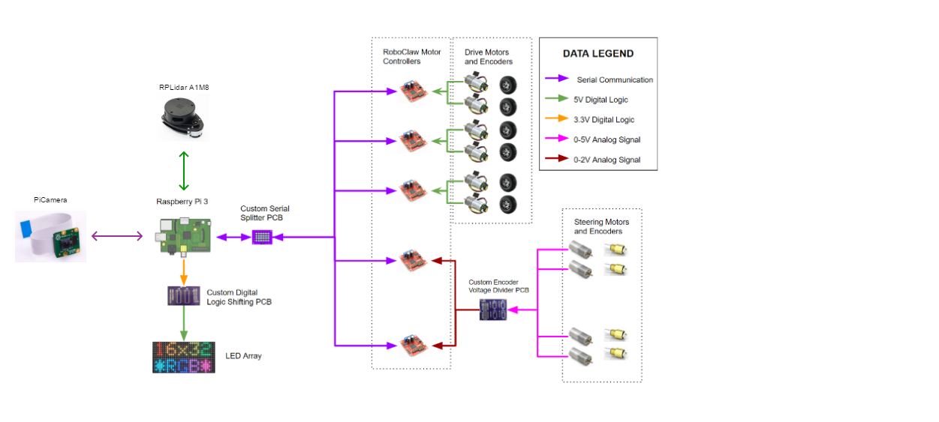
Functional Decomposition
Notes:
(DATA FLOW) 5v analog from corner wheels motor to voltage divider, goes to 2v analog to microcontrollers connected to serial splitter PCB, which is transmitted to raspberry pi. 3.3v digital logic to logic shifter pcb which transmits 5v to the led array

Slide 12
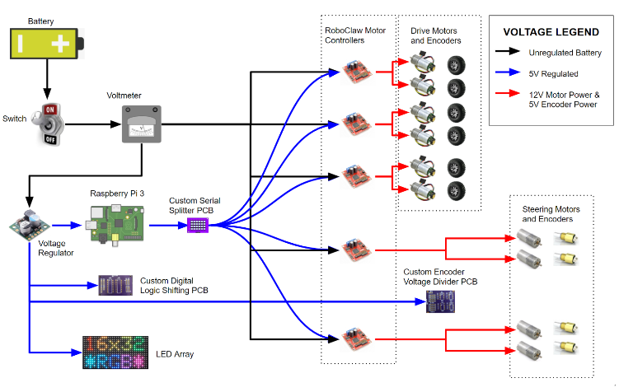
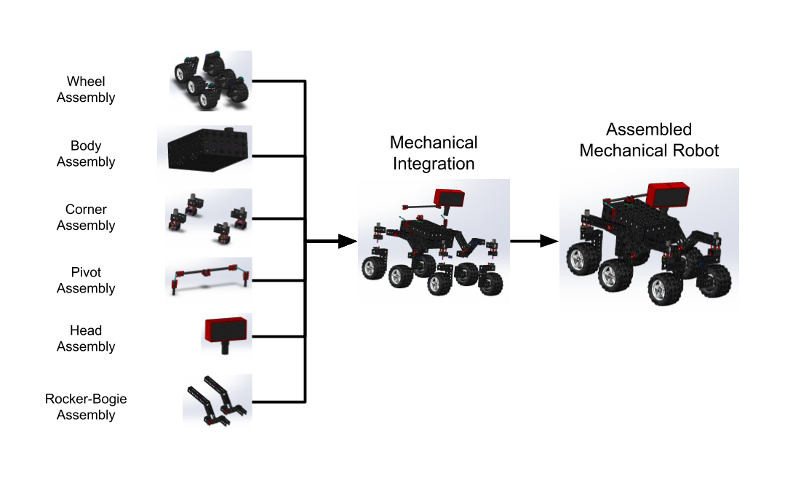
Detailed Design
Client
SLAM
MobileNet V2
Notes:
(DATA FLOW) 5v analog from corner wheels motor to voltage divider, goes to 2v analog to microcontrollers connected to serial splitter PCB, which is transmitted to raspberry pi. 3.3v digital logic to logic shifter pcb which transmits 5v to the led array

Slide 13
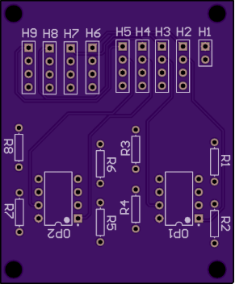
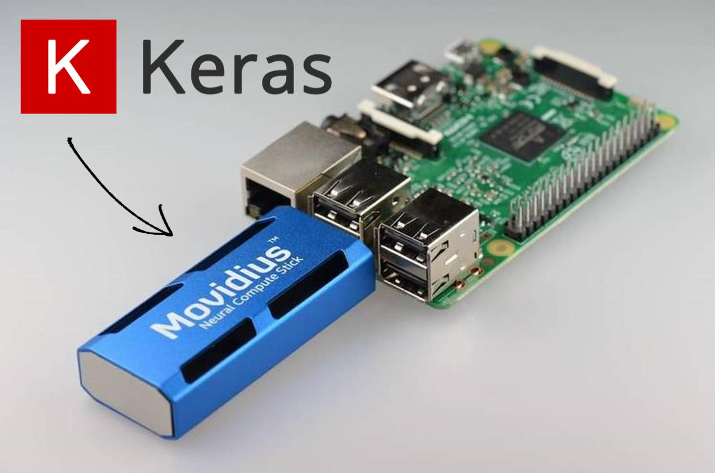
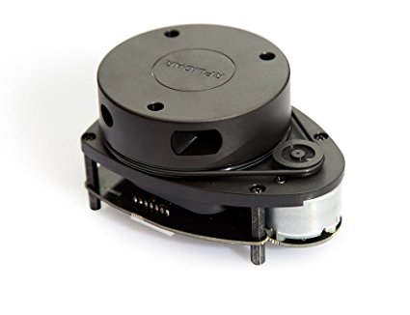
HW/SW/Technology Platforms Used
React.js
Python
Tornado (python sockets)
Google Maps
Chart.js
Npm
Keras (TensorFlow backend)
Raspi
Intel Movidius Compute Stick
RPLidar
RoboClaw Motor Controllers
OshPark PCBs

Slide 14
Test Plan
Electrical testing of PCBs and drive motors
Mechanical testing of rover using weights and range of motion testing
Unit testing of software components
Operational testing in controlled environment

Slide 15
Prototype Implementations

Slide 16
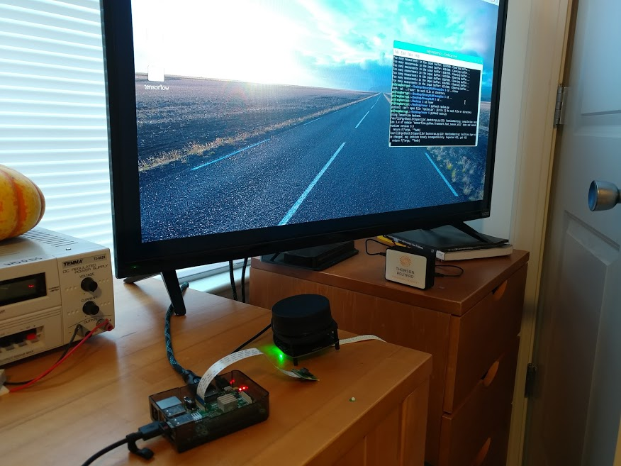

Slide 17
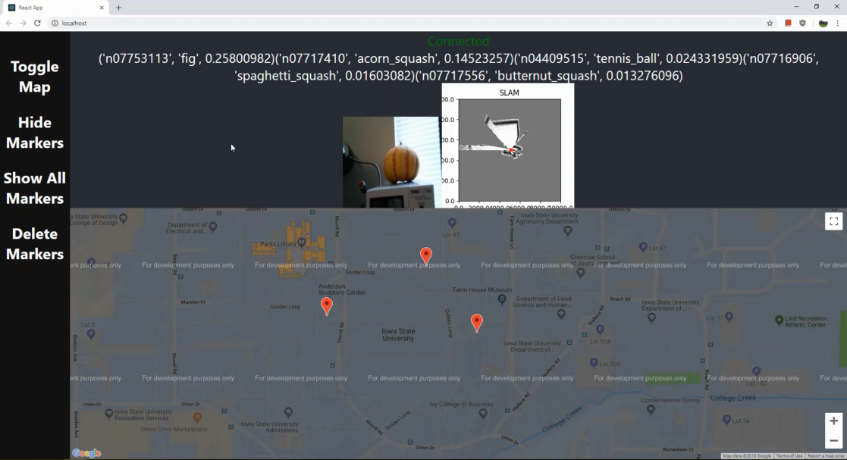
Prototype Implementations

Slide 18
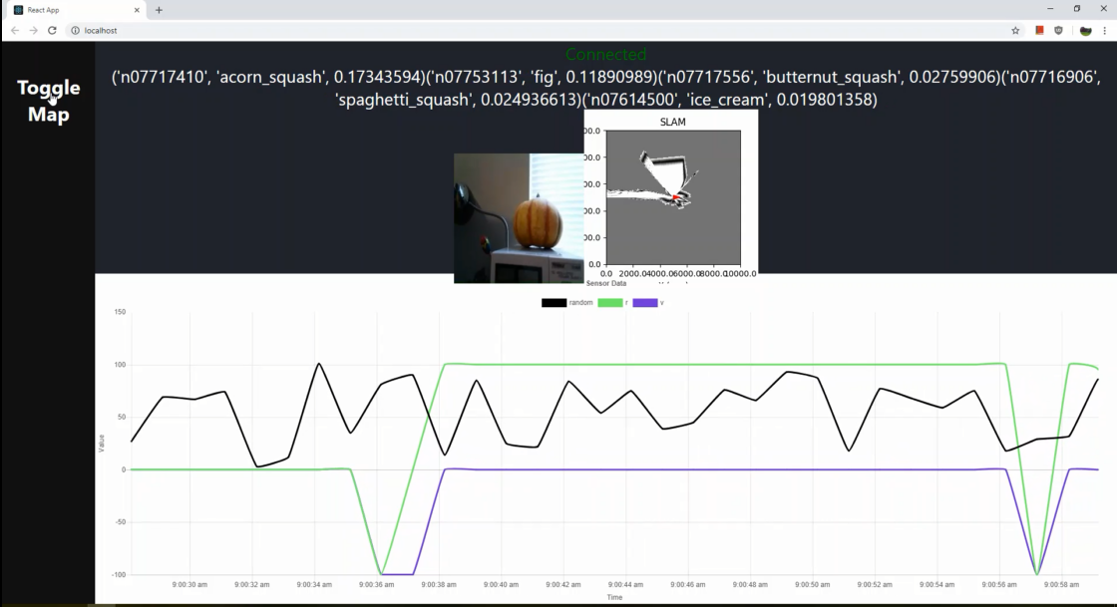
Prototype Implementations

Slide 20
Current Project Status with respect to milestones
End-of-semester milestones:
Basic software prototype with camera integration and video processing.
Status: Done.
Hardware ordered, counted, and grouped by component.
Status: Done.
Testing of Software and Hardware components
Status Started.
Machining and fabrication of rover complete.
Status: Started.
Rover construction complete or near complete (stretch goal).
Status: Not done.

Slide 21
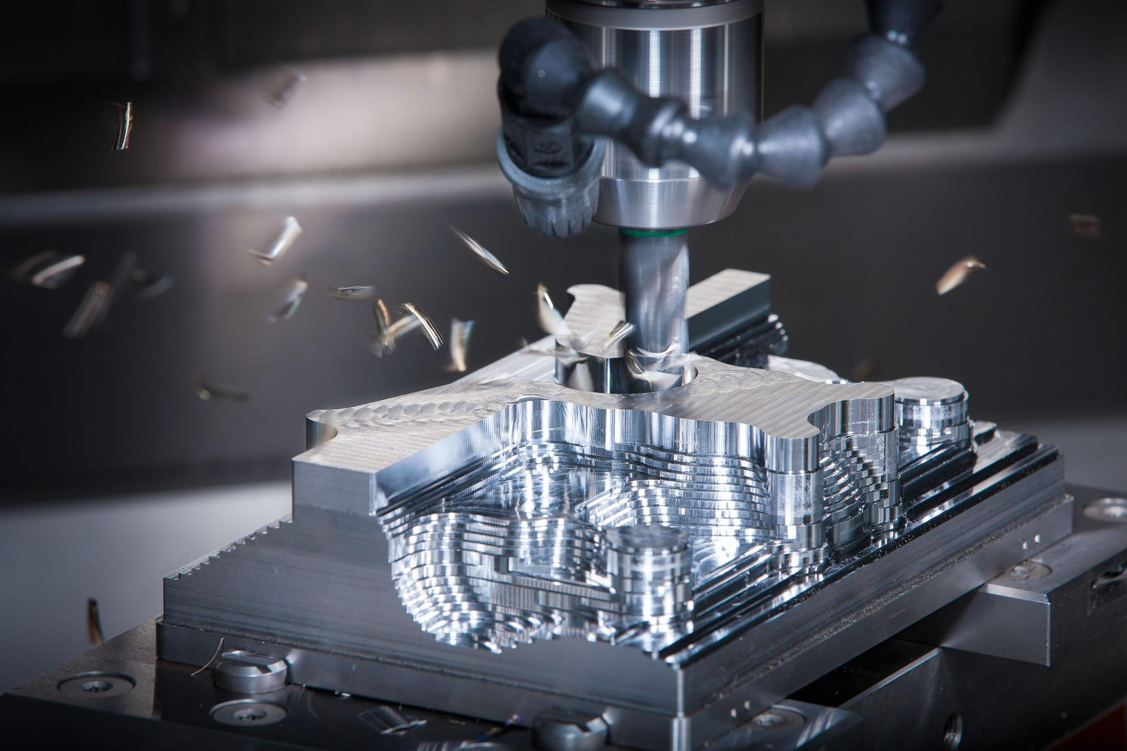
Task Responsibility
Due to being a team of software/computer majors with minimal hardware experience, as well as the simplicity of the project’s software due to pre-existing libraries and tutorials, one team member was selected to work on the software prototype while the rest of the team assembled parts and became comfortable with hardware work.
Hardware
Mitchell - electrical testing, soldering.
Future: body assembly and electrical integration
Douglas - part cataloging and grouping.
Future: body assembly and mechanical integration
Calvin - body machining and fabrication, laser cutting.
Future: Software refinement, body machining, and body assembly.
Software
Sam - camera and LIDAR integration, prototype UI with controls, sensor charting, basic image recognition, google maps integration.
Future: Software refinement, functionality testing, body assembly

Slide 22
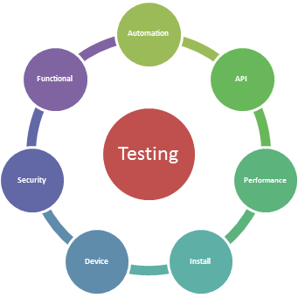
Plan for next semester
Construction of the Mars rover chassis will begin over winter break and into the spring semester.
Once the rover has been constructed or nearly constructed, testing and software integration/refinement will begin.

